Slide 1
Chapter 8: Facility Layout
LO8–1: Analyze the common types of manufacturing layouts.
LO8–2: Illustrate layouts used in nonmanufacturing settings.
McGraw-Hill/Irwin
Copyright © 2014 by The McGraw-Hill Companies, Inc. All rights reserved.

Slide 2
Layout Decisions
Facility layout: the process of determining placement of departments, workgroups within departments, workstations, machines, and stock-holding points within a facility
This process requires the following inputs:
  Specification of the objectives used to evaluate the design
  Estimates of product or service demand
  Processing requirements
  Space requirements for the elements
  Space availability within the facility
Notes:
3

Slide 3
Basic Production Layout Formats
Workcenter
Also called a job-shop or functional layout
Similar equipment are grouped together
Assembly line
Also called a flow-shop layout
Work processes are arranged according to the steps by which the product is made
Manufacturing cell
Dissimilar machines are grouped to work on similar products
Project layout
Product remains at one location
Notes:
4

Slide 4
Case of Stamping Machine in Blade Making
Importance of Layout
Layout 1
Layout 3
Layout 2

Slide 5
Workcenter Layout
Given
  The flow (number of moves) to and from all departments
  The cost of moving from one department to another
  The existing or planned physical layout of the plant
Determine
  The “best” locations for each department, where best means maximizing flow, which minimizes costs
Notes:
6

Slide 6
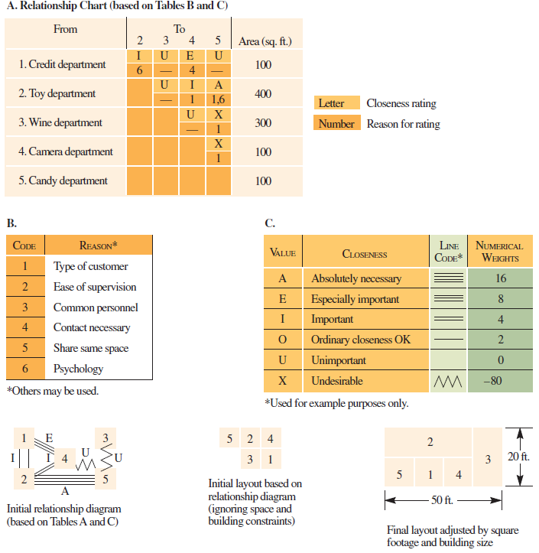
Systematic Layout Planning for a Floor of a Department Store
Exhibit 8.8

Slide 7
Assembly Line
Assembly line: progressive assembly linked by some material handling device
  Some form of pacing is present and the allowable processing time is equivalent for all workstations
Important differences:
  Material handling devices
  Line configuration
  Pacing
  Product mix
  Workstation characteristics
  Length
Example:Bangladesh Garmenting Factory Layout,
Gerber Software

Slide 8
Assembly-Line Design
Cycle time: a uniform time interval in which a moving conveyor passes a series of workstations
  Also the time between successive units coming off the line
Assembly-line balancing: assigning all tasks to a series of workstations so that each workstation has no more than can be done in the cycle time
Precedence relationship: the order in which tasks must be performed in the assembly process

Slide 9
Assembly-Line Balancing
Specify the sequential relationships among tasks
Determine the required cycle time
Determine the theoretical minimum number of workstations
Select a primary and secondary assignment rule
Assign tasks
Evaluate the efficiency of the balance
Rebalance if needed

Slide 10
Splitting Tasks That Are Too Long for the Cycle Time
Split the task
  Can we split the task into two different tasks
Share the task
  Can an adjacent workstation do part of the work
Use parallel workstations
  Using parallel workstations doubles the cycle time available for the task
Use a more skilled worker
  Can a more skilled worker complete the task faster
Work overtime
  Use longer cycle time and make up needed production using overtime
  Affects all workstations
Redesign
  Can we redesign the product to save time

Slide 11
Flexible Line Layouts
Exhibit 8.11 Partial

Slide 12
Flexible Line Layouts
Exhibit 8.11 Partial

Slide 13
Cells
Cellular layouts allocate dissimilar machines into cells
Widely used in metal fabricating, computer chips manufacture, and assembly work
Objective is to gain the benefits of assembly lines with workcenter kinds of production
  Better human relations
  Improved operator expertise
  Less in-process inventory and material handling
  Faster production setup

Slide 14
Developing a Manufacturing Cell
Grouping parts into families that follow a common sequence of steps
Identifying dominant flow patterns of parts families as a bases for location of processes
Physically grouping machines and processes into cells

Slide 15
Project Layout
Is characterized by a relatively low number of production units
Visualize the product as the hub of a wheel with materials and equipment arranged concentrically around the production point
A high degree of task ordering is common
To the extent that this precedence determines production stages, a project layout might be developed by arranging materials according to their technological priority

Slide 16
Retail Service Layout
Goal is to maximize net profit per square foot of floor space
Servicescapes
  Ambient conditions
    Background characteristics, such as noise
  Spatial layout and functionality
    Planning the circulation path of customers and grouping merchandise
  Signs, symbols, and artifacts
    Parts of the service that have social significance
Notes:
37

Slide 17
Exercise
A Store Manager has to decide on the layout of his store. Two options presented to him have following:
A1+B1=A2+B2=100%
Option 1:
Aisle area A1 sft
Rack Area B1 sft
Option 2:
Aisle area A2 sft
Rack Area B2 sft
A1>A2
How would the Store Manager select the better option?

Slide 18
Marketing Research and Retail Layout
People in supermarkets tend to follow a perimeter pattern in their shopping behavior
Sale merchandise placed at the end of an aisle in supermarkets almost always sells
Non-selling departments should be placed either on upper floors or in “dead” areas
Locations nearest the store entrances and adjacent to front window displays are most valuable
Why we buy: The Science of Shopping-Paco Underhill

Slide 19
Office Layout
More open offices
Low divider walls
Fewer walls fosters greater communication and teamwork
Size and orientation of desks indicates importance of people behind them

Slide 20
Summary
The focus is on understanding the quantitative techniques used to design manufacturing layouts
  Workcenter, assembly line, manufacturing cell, and project layouts
Workcenter layouts involve arranging functional workcenters to optimize the flow between these areas
Assembly-line design is centered on defining the work content of workstations spaced along the line
  Assembly-line balancing
Manufacturing cells are used for lower volume settings
Other types of layouts include those used in retail stores and offices

Slide 21
Systematic Layout Planning
Numerical flow of items between workcenters
  Can be impractical to obtain
  Does not account for the qualitative factors that may be crucial to the placement decision
Systematic layout planning
  Accounts for the importance of having each department located next to every other department
  Is also guided by trial and error
    Switching work centers then checking the results of the “closeness” score
Notes:
9

Slide 22
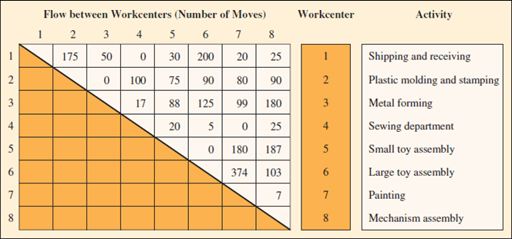
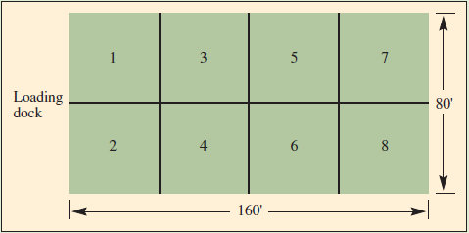
Example 8.1: Interworkcenter Flow, and Building Dimensions and Workcenters
Exhibits 8.1 and 8.2

Slide 23
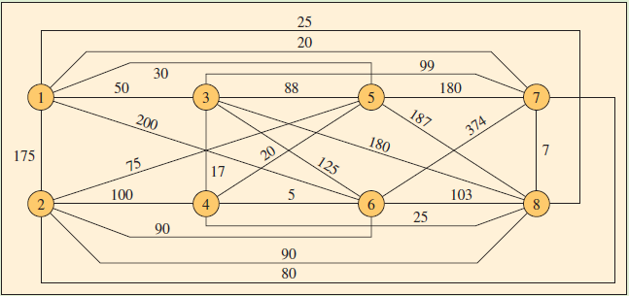
Example 8.1: Interworkcenter Flow Graph with Number of Annual Movements
Exhibit 8.3

Slide 24
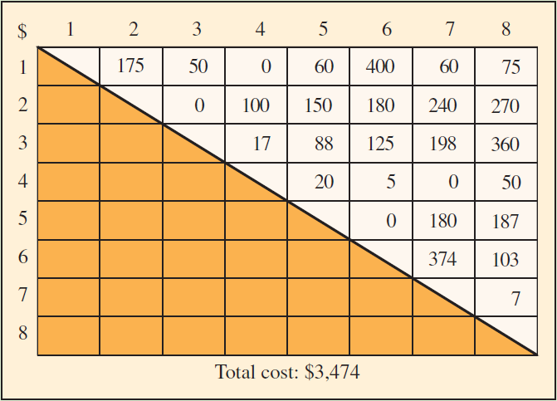
Example 8.1: Cost Matrix–First Solution
Exhibit 8.4

Slide 25
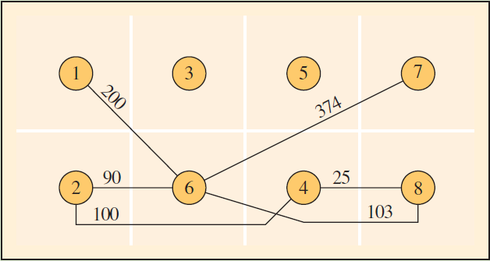
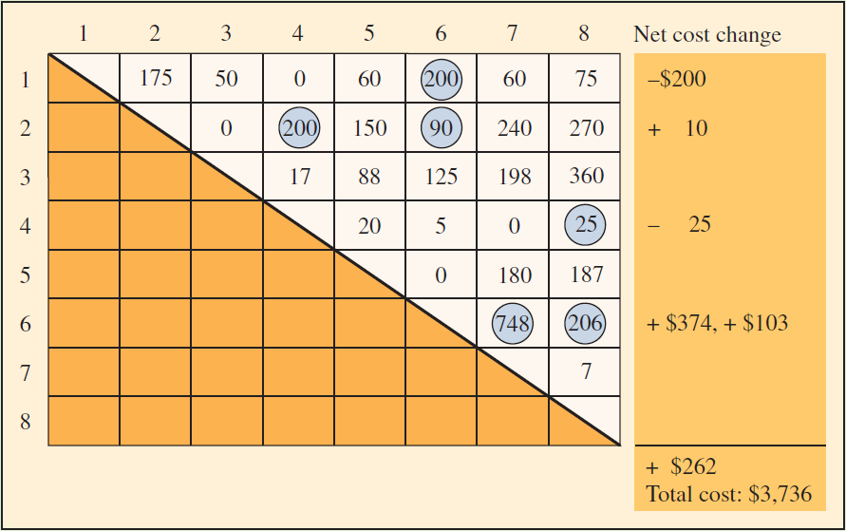
Example 8.1: Revised Interworkcenter Flowchart and Cost Matrix–Second Solution
Exhibits 8.5 and 8.6

Slide 26
Example 8.1: Toy Factory
Goal is to arrange eight workcenters to minimize interdepartmental handling cost
Assume all workcenters have same space and fit in building
All material is transported in standard crates by forklift
Transportation costs are $1 to move between adjacent workcenters
  Extra $1 for each workcenter in between

Slide 27
Steps
Illustrate the interworkcenter flow by a model
Determine the cost of this layout
Search for workcenter location changes that will reduce costs

Slide 28
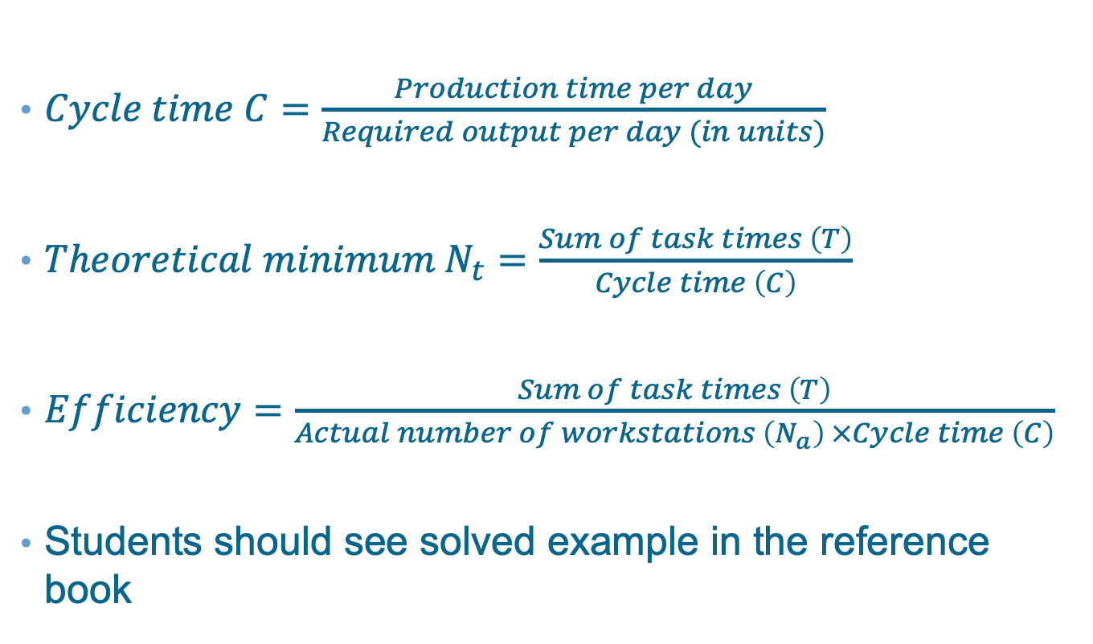
Assembly-Line Balancing Formula
$Cycle time C=\frac{Production time per day}{Required output per day (in units)}$
$Theoretical minimum N_{t}=\frac{Sum of task times \left(T\right)}{Cycle time \left(C\right)}$
$Efficiency=\frac{Sum of task times \left(T\right)}{Actual number of workstations \left(N_{a}\right) ×Cycle time \left(C\right)}$
Students should see solved example in the reference book

Slide 29
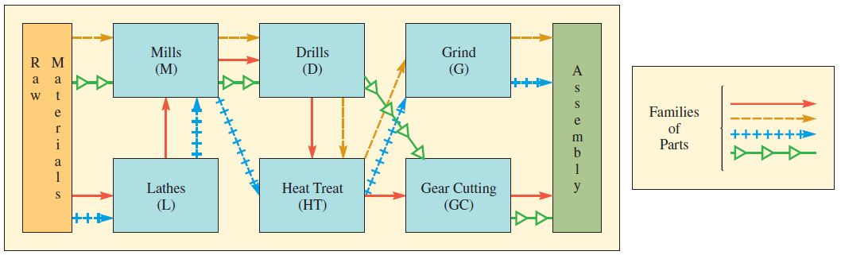
Example: Original Workcenter Layout
Exhibit 8.12A

Slide 30
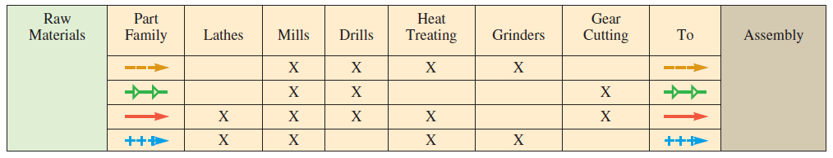
Example: Routing Matrix Based upon Flow of Parts
Exhibit 8.12B

Slide 31
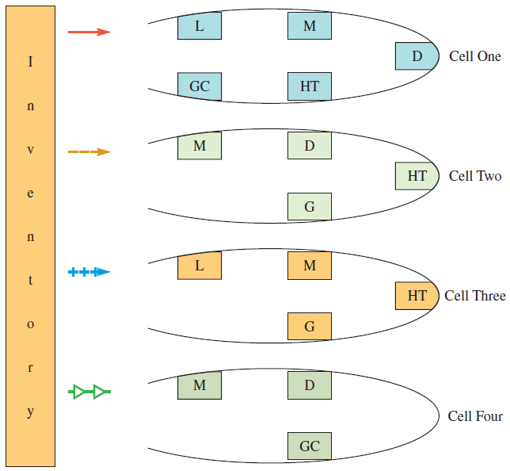
Example: Reallocating Machines to Form Cells
Exhibit 8.12C

Slide 32
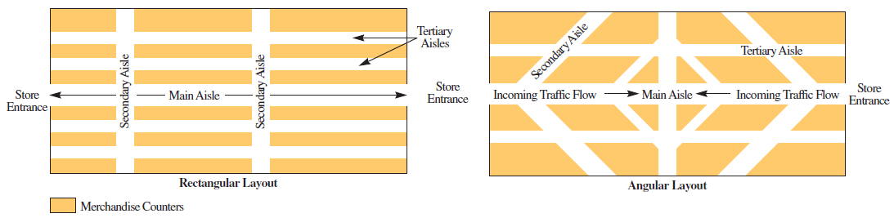
Alternative Store Layouts
Exhibit 8.14

